Slide 1
MPCA LAB MINI PROJECT
PROJECT TITLE: SMART MALL MANAGEMENT SYSTEM
SECTION: F(BATCH 1)
SATYAM RUDRADUTTA DWIVEDI - PES2UG19CS370
SAI KALYAAN PALLA-PES2UG19CS354
RONGALI LALITH VARDHAN - PES2UG19CS337
SAI GRUHEETH N - PES2UG19CS352

Slide 2
PROBLEM STATEMENT
Our project addresses the problem of automation of enforcement of protocols by monitoring the number of people that can enter a shopping complex or any place of trade by sensing the ingress and egress,by this it limits the occupants of any closed space and also performs a temperature screening of people who wants to enter and let’s the person enter only and only if the temperature is below the safe threshold limit and as an additional feature to control the space’s temperature we have a ambient temperature sensor which ramps up exhaust fans in case of rise in temperature

Slide 3
INTRODUCTION
We have implemented the safety system by using two PASSIVE INFRARED SENSORS(PIRs) and a servo motor for control the people move in and out of the mall. There is a temperature sensor to control the temperature of the mall by turning on exhaust fan driven by a motor.
The screening mechanism is linked with the entry motor and this way we have interlinked the working of these 2 different systems and let’s the ingress for people who are below the safe temperature.
We have a LCD display to show the current status on number of people in the mall/building as an output point of the system

Slide 4
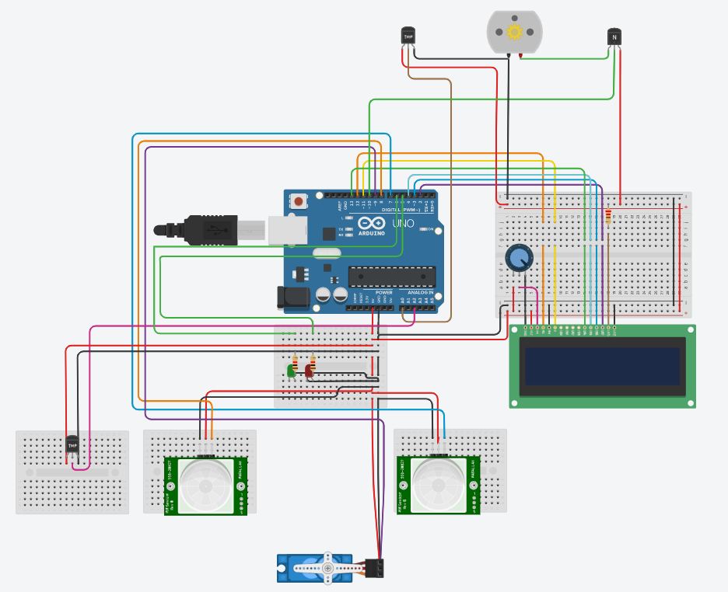
BLOCK DIAGRAM

Slide 5
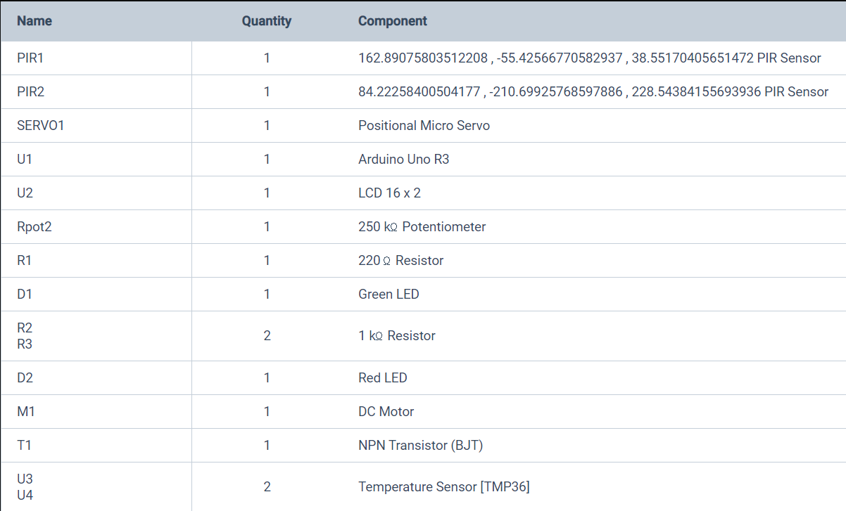
REQUIRED COMPONENTS

Slide 6
PROJECT DESCRIPTION
The main intention of this project is to mitigate the way people go in and out of the mall so as to maintain social distancing. As soon as a person approaches the mall, their temperature is recorded. If the temperature exceeds that of the safe limit the person is barred entry from the mall. In order to maintain social distancing, we limit the number of people who can be inside the mall to 100. In order to gain access to the mall, the person has be in the safe temperature range and there should be enough space in the mall to accommodate the person. We keep track of the number of people in the mall using two PIR sensors. The PIR sensors only gets activated if the green LED turns on(person has an acceptable body temperature).
In case the person meets the required specifications in order to enter the mall, the servo rotates with a delay to grant entry in to the mall.
The counter is updated when a person enters or leaves the mall.

Slide 7
PROJECT DESCRIPTION
A temperature sensor is installed within the mall to maintain a constant temperature inside. The fans ramp up when the temperature increases and the fans remain idle if the temperature is too low.

Slide 8
APPLICATIONS
This integrated system can be used in any entry point of a multi-visitor suburban area.
It ensures the safety check of the visitors from the on going pandemic to avoid any protocol violations.
Further this can integrated with automatic pressure required for sanitizer sprays.
A sound alert system can be implemented for any bypassers if any system condition is violated.

Slide 9
REFERENCES(Website links, Books etc.
https://drive.google.com/file/d/1QPDEKh7oTCqSHaro3GVyPYMAPkIlmLbL/view?usp=sharing
www.arduino.cc
https://www.tutorialspoint.com/arduino/index.htm

Slide 10
END
THANK YOU

